Slide 1
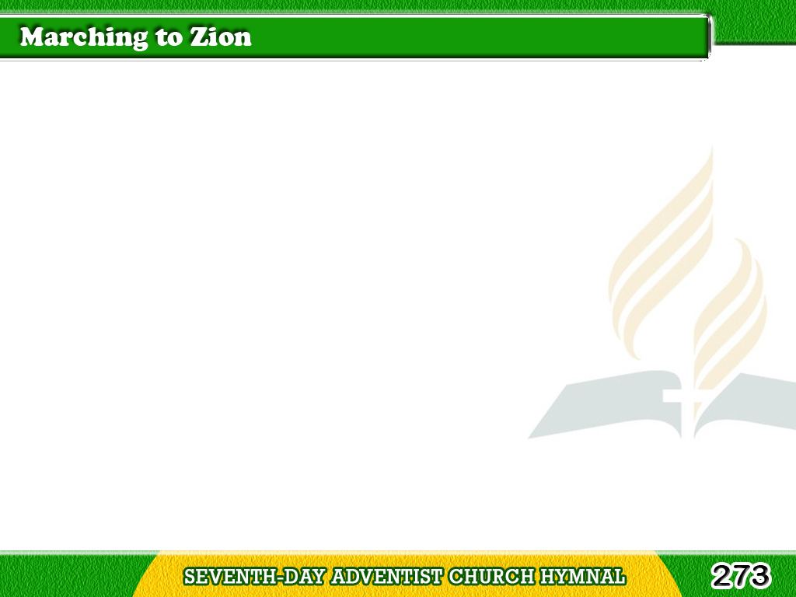
1/4
Come, we that love the Lord,
And let our joys be known;
Join in a song with sweet accord,
Tagalog
Version

Slide 2
1/4
Join in a song
with sweet accord,
And thus surround the throne,
And thus surround the throne.
Tagalog
Version

Slide 3
1/4
Chorus
We’re marching to Zion,
Beautiful, beautiful Zion;
We’re marching upward to Zion,
The beautiful city of God.
Tagalog
Version

Slide 4
2/4
Let those refuse to sing
Who never knew our God;
But children
of the heavenly King,
Tagalog
Version

Slide 5
2/4
But children
of the heavenly King,
May speak their joys abroad,
May speak their joys abroad.
Tagalog
Version

Slide 6
2/4
Chorus
We’re marching to Zion,
Beautiful, beautiful Zion;
We’re marching upward to Zion,
The beautiful city of God.
Tagalog
Version

Slide 7
3/4
The hill of Zion yields
A thousand sacred sweets,
Before we reach
the heavenly fields,
Tagalog
Version

Slide 8
3/4
Before we reach
the heavenly fields,
Or walk the golden streets,
Or walk the golden streets.
Tagalog
Version

Slide 9
3/4
Chorus
We’re marching to Zion,
Beautiful, beautiful Zion;
We’re marching upward to Zion,
The beautiful city of God.
Tagalog
Version

Slide 10
4/4
Then let our songs abound,
And every tear be dry;
We’re marching through
Immanuel’s ground,
Tagalog
Version

Slide 11
4/4
We’re marching through
Immanuel’s ground,
To fairer worlds on high,
To fairer worlds on high.
Tagalog
Version

Slide 12
4/4
Chorus
We’re marching to Zion,
Beautiful, beautiful Zion;
We’re marching upward to Zion,
The beautiful city of God.
Tagalog
Version

